Slide 1
Tech-Champion 2015 predictive Analytics On real system data

Slide 2

Topic Description
Target: Make predictive analytics on real system data using powerful algorithms.
Data are got from real network
Data will be provided as group. For every single group, a model is needed
Find the most suitable model by evaluating different kind of algorithms to make the prediction in every single group
Improve the predictive analysis results by algorithms tuning
Evaluation Criteria
For predictive analytics on each data set, the minimum requirement shall be fulfilled
Winner will deliver the most models in required time and have the best accuracy and other KPIs for their models
Technical Requirement
Programing language used in ML (for example, Java/Scala/R/Python)
Basic understanding about primary ML algorithms
System Data Models

Slide 3
General info
The data of different groups are put into different folders.
The original format of each data set are “csv”. Team can convert it (or use them directly) to adapt to your analytics platform.
Any requirement questions, please feel free to go to Tony Du. And Tony Du will try to reply all via E-mail to make team has the same understanding on some details.
Any technical questions, please try to find the answers by team selves. Discussion/sharing would be bonus but not guaranteed from Topic Owner/Jury.

Slide 4
Use case 1: Single counter
Purpose:
Find the relation between the network failure and this specific counter
Details:
The training set and test set are put separately.
Only one counter is included in this Use Case.
For Network failure, 1 means the failure occurs, 0 means not.

Slide 5
Use case 2: Dual counters
Purpose:
Find the relation between the network failure and the two counters
Details:
The training set and test set are put separately.
Two counters are included in this Use Case.
For Network failure, 1 means the failure occurs, 0 means not.

Slide 6
Use case 3: Multiple counters I
Purpose:
Find the relation between the network failure and several counters
Details:
The training set and test set are put separately.
Several counters are included in this Use Case.
For Network failure, 1 means the failure occurs, 0 means not.

Slide 7
Use case 4: Multiple counters II
Purpose:
Find the relation between the network failure and several counters
Details:
The training set and test set are put separately.
Several counters are included in this Use Case.
For Network failure, 1 means the failure occurs, 0 means not.

Slide 8
Use case 5: Predict the CSR
Purpose:
Predict the CSR based on the normal/abnormal time-series counters
Details:
Training Set: CUDB01_LdapFrontEnds.csv ; CUDB02_LdapFrontEnds.csv
Test Set: CUDB03_LdapFrontEnds.csv (abnormal); CUDB04_LdapFrontEnds.csv (normal)
Find a way to predict the network failure in CUDB03_LdapFrontEnds.csv
Try to find the abnormal Front-end in CUDB03_LdapFrontEnds.csv
Evaluation Criteria:
The CSR is predicted. The abnormal FE are found, and how abnormal are interpreted.
The method should be flexible to be used for other counters.
The method should be easily deployed.

Slide 9
Use case 6: OPEN investigation
Purpose:
Find a Topic at Kaggle and have a try
Evaluation Criteria
Subjective

Slide 10
Evaluation Criteria
Objective (70%)
For predictive analytics on each data set, the minimum requirement is fulfilled. (30%)
(Minimum requirement: Accuracy > 0.6 AND Precision > 0.6 AND Recall > 0.6)
Higher Accuracy/Precision/Recall, higher value (40%)
Subjective (30%)
Any shining points in every single phase of CRISP-DM would add value. (10%)
Better data visualization would add value. (10%)
Other shining points if any (10%)
Score calculation: Topic 1~6 Objective Score + Topic 1~6 Subjective Score

Slide 11
References and useful materials
Machine Learning Library (MLlib) Guide (@Spark)
Machine Learning by Stanford University (English)
斯坦福大学公开课 ：机器学习课程 (Chinese)
Kaggle: The Home of Data Science

Slide 13
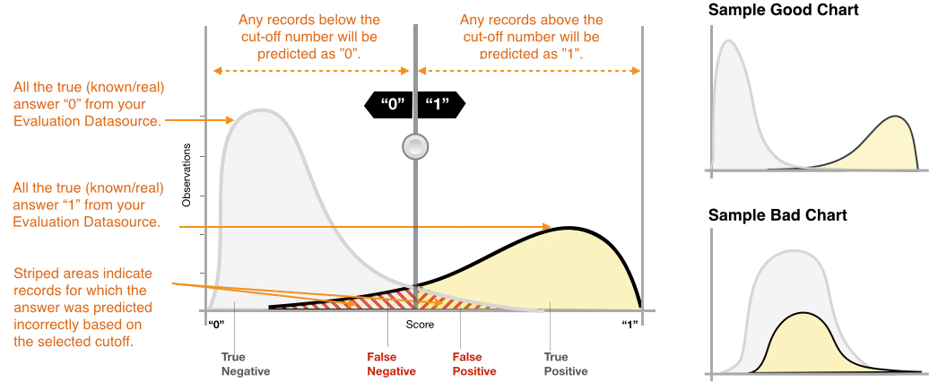
Evaluation
Prediction
Abbreviation | Meaning
TPR | True Positive Rate (Sensitivity) TPR = TP/(TP+FN)
FPR | False Positive Rate (1-Specificity) FPR = FP/(FP+TN)
 | 1 | 0
1 | True Positive ( TP) | False Negative (FN)
0 | False Positive (FP) | True Negative (TN)
Actual
Reference: http://docs.aws.amazon.com/zh_cn/machine-learning/latest/dg/evaluating_models.html

Slide 14
Evaluation
Accuracy (ACC) measures the fraction of correct predictions. The range is 0 to 1. A larger value indicates better predictive accuracy:
Precision measures the fraction of actual positives among those examples that are predicted as positive. The range is 0 to 1. A larger value indicates better predictive accuracy:
Recall measures the fraction of actual positives that are predicted as positive. The range is 0 to 1. A larger value indicates better predictive accuracy:
Reference: http://docs.aws.amazon.com/zh_cn/machine-learning/latest/dg/evaluating_models.html

